Slide 1

Nationwide
Enterprise
Middleware
November 2016
IBM Confidential

Slide 2
Contents
Why NEM
NEM components
What NEM is used for
NEM platform
NEM infrastructure

Slide 3



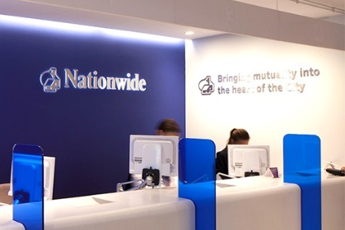










Multi-channel without NEM and APIs
CIS
AND
Base24
Registration
Manager

Slide 4
Multi-channel without NEM and APIs
Fast changing, high speed to market
Tailored to users and devices
“Systems of Engagement”
Heterogeneous
Hard to change
“Systems of Record”
CIS
AND
Base24
Registration
Manager

Slide 5
Digital Transformation with NEM and APIs
Mobile API
Web API
Watch API
Branch API
Nationwide Enterprise Middleware
Common Automated Processes
Common Services
CIS
AND
Base24
Registration
Manager

Slide 6
Digital Transformation with NEM and APIs
Fast changing, high speed to market
Tailored to users and devices
“Systems of Engagement”
Mobile API
Web API
Watch API
Branch API
Standardised, evolution
Re-use oriented, high-speed integration
“Business Process Orchestration”
Nationwide Enterprise Middleware
Common Automated Processes
Common Services
Heterogeneous
Hard to change
“Systems of Record”
CIS
AND
Base24
Registration
Manager

Slide 7
Zooming in: NEM Solution Architecture

Slide 8
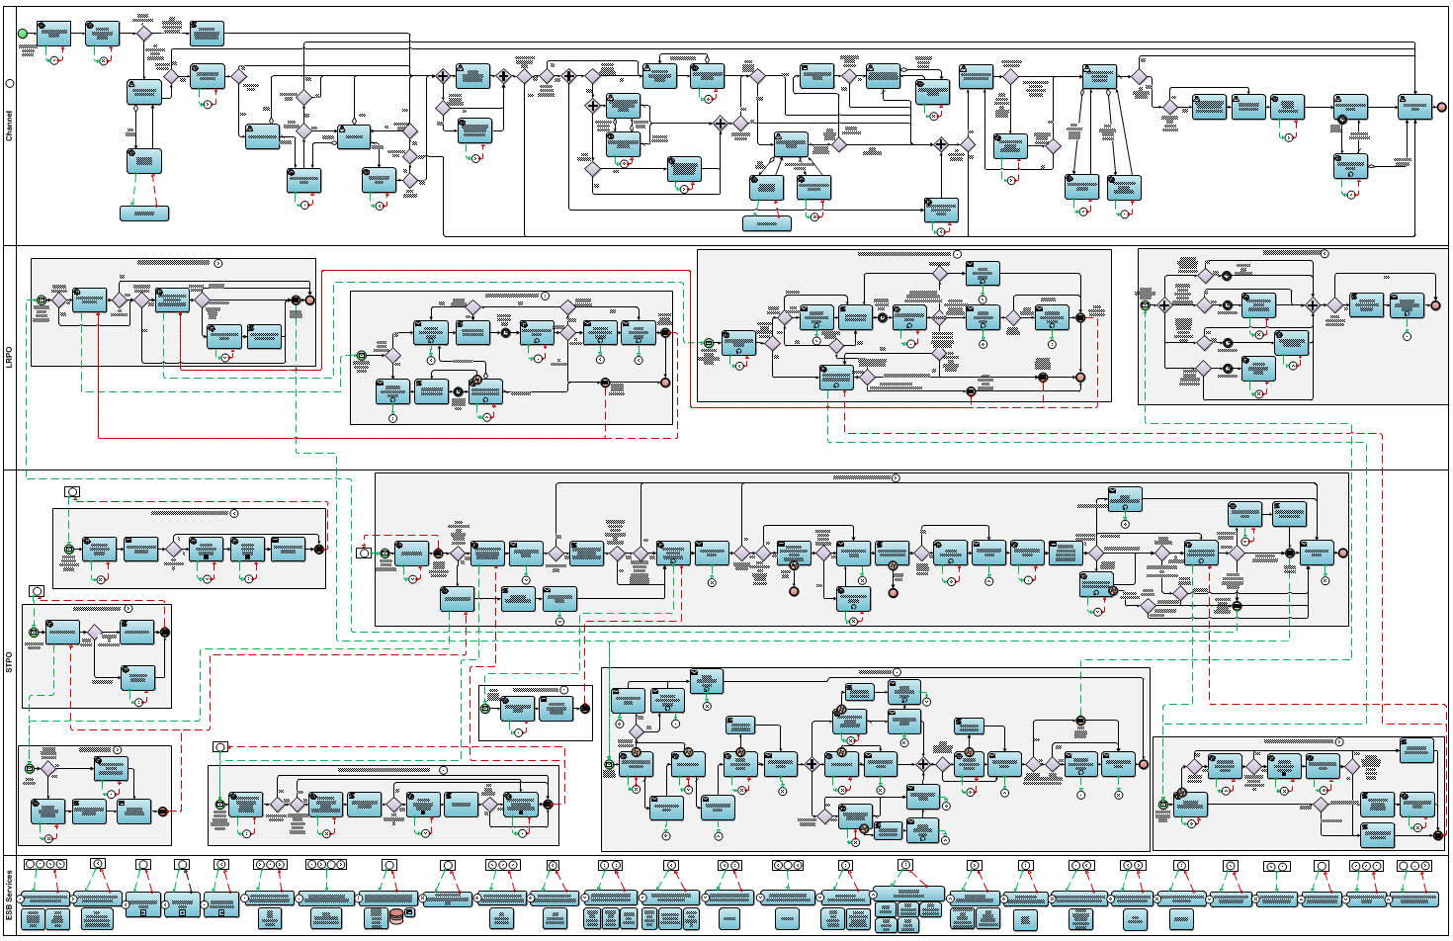
The First Application: Real-Time Savings Account Opening

Slide 9
The First Application: Real-Time Savings Account Opening
1. Capture Customer’s Application
Channel (UI)
Activate Customer’s Account Offline
Async (LRPO)
Retrieve
Eligible Nominated Accounts
2. Create Customer Record & Verify Customer’s Application
Mitigate Security
Risks
Sync (STPO)
Verify Eligibility
Activate Customer’s Account
Retrieve
Customer Details
Verify UN Sanctions
ESB

Slide 10
NEM Platform Products

Slide 11
Infra- structure Example: STPO

Slide 12
Infra- structure Example: LRPO

